Slide 1
Agenda :
Top Features in Visual Studio 2022
New Debugger Features
Shortcut Keys

Slide 2
Technology : Visual Studio
Visual Studio 2022 marks the latest milestone in Microsoft's flagship integrated development environment (IDE), representing a significant evolution in the tools and capabilities available to developers. The latest enhancements introduced in Visual Studio 2022 present a multitude of compelling features that greatly captivate our attention :
64-bit IDE
.NET 6 support
Intellicode
Hot Reload
Find in Files is faster

Slide 3
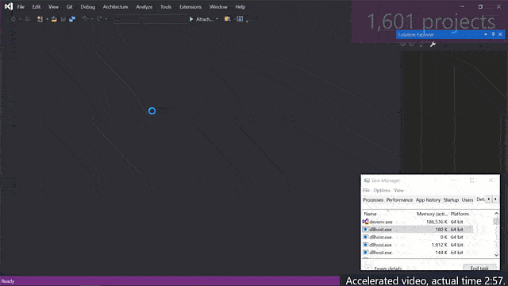
Technology : Visual Studio
64-bit IDE :
Visual Studio is now available as a 64-bit application.
This transition brings significant improvements in project loading and execution times compared to previous 32-bit versions.
Users can now effectively work on projects of any size and complexity.
The transition to 64-bit architecture allows for better utilization of system resources, resulting in enhanced performance.
In Visual Studio 2022, the rapid loading of 1,601 projects containing 298,326 files was demonstrated, highlighting the efficiency of the new version.
Devenv.exe has been migrated from 32 bit to 64 bit. Providing larger memory which gives developers more roam to edit & debug huge & complex applications.
Benefits of this feature to developer:
Faster Performance: Visual Studio's transition to 64-bit ensures quicker project loading and execution times.
Handling Complexity: Developers can seamlessly manage projects of any size and complexity.

Slide 4
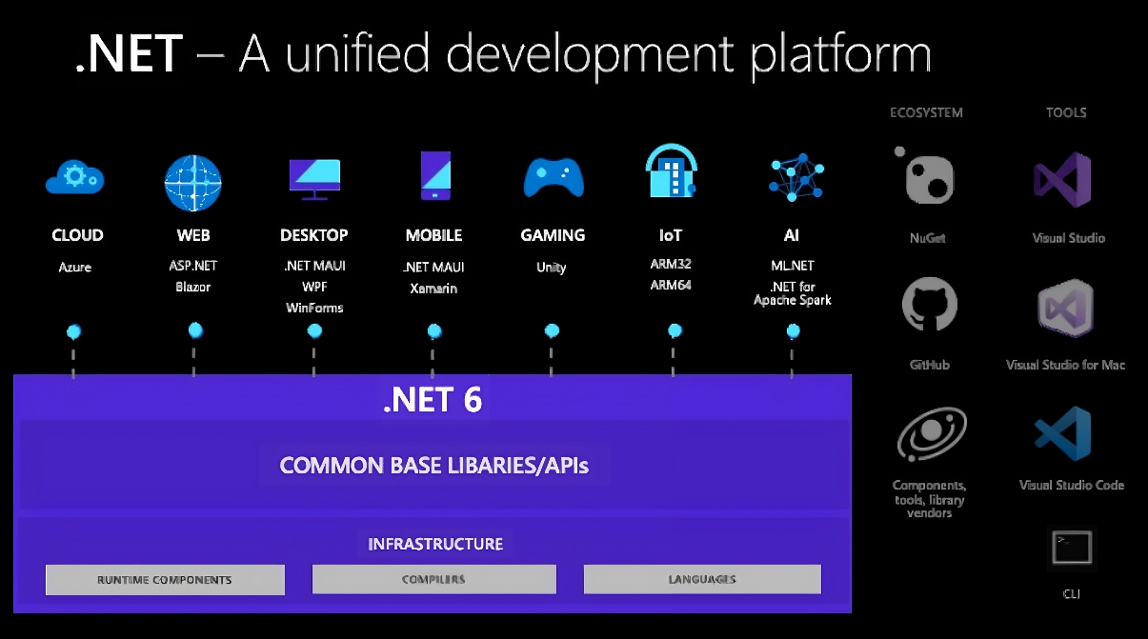
Technology : Visual Studio
.NET 6 support :
Visual Studio 2022 now fully supports .NET 6.
.NET 6 is a unified framework enabling development of web, client, and mobile apps.
Developers can target both Windows and Mac operating systems with .NET 6.
Visual Studio 2022 provides comprehensive tooling and support for .NET 6 development, enhancing developer productivity and flexibility.
Benefits of this feature to developer:
Unified Development: .NET 6 enables multi-platform application development.
Cross-Platform Compatibility: Target both Windows and Mac OS with .NET 6.
Enhanced Productivity: Visual Studio 2022 boosts efficiency for .NET 6 development.
Latest Features & Performance: Access the newest features and optimizations.
Future-Proofing: Stay current with cutting-edge Microsoft technology.

Slide 5
Technology : Visual Studio
.NET 6 support :
This release marks the first time that .NET will be supported on macOS Apple Silicon. It will also be supported on Windows Arm64.
New features in .NET 6 include:
Hot Reload, which allows code changes to be viewed without needing to restart the app
OpenTelemetry and dotnet monitor support
Improvements to Visual Basic in the Visual Studio experience and Windows Form project experience
The ability to render Blazor components from JavaScript
HTTP/3 support
Support for symbolic links in File IO
Support for OpenSSL, the ChaCha20Poly1305 encryption scheme, and runtime defense-in-depth mitigations
Source generators and analyzers

Slide 6
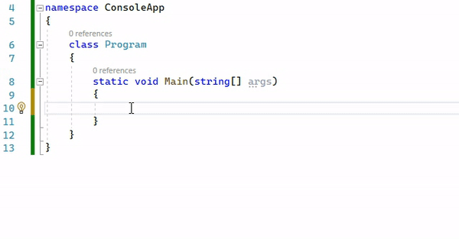
Technology : Visual Studio
Intellicode :
AI-Powered Code Completion: Intellicode utilizes AI to suggest code completions based on context.
Contextual Suggestions: Suggestions are tailored to variable names, functions, and the specific code being written.
The AI suggests next chunk of the code to right of the cursor based on the current context. It is trained on 500,000 public repositories of the GitHub. Previously this only worked with C#, Microsoft has made it possible for multiple languages.
IntelliTrace: Move back & forth among different brake points to easily perform debugging with state management.
Benefits of this feature to developer:
Speed: AI-powered suggestions accelerate coding, saving time.
Accuracy: Contextual completions ensure code consistency and reduce errors.
Focus: Developers can concentrate on higher-level tasks with automated completion.
Learning Aid: Helps developers learn syntax and patterns faster.
Efficiency: Overall, Intellicode boosts developer productivity and effectiveness.

Slide 7
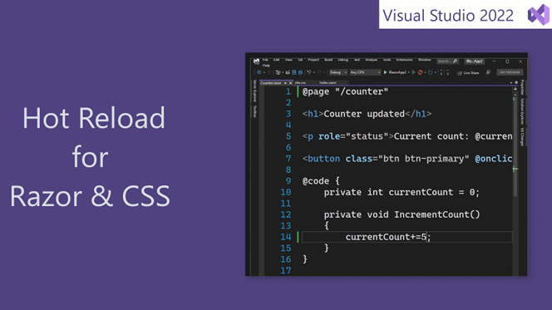
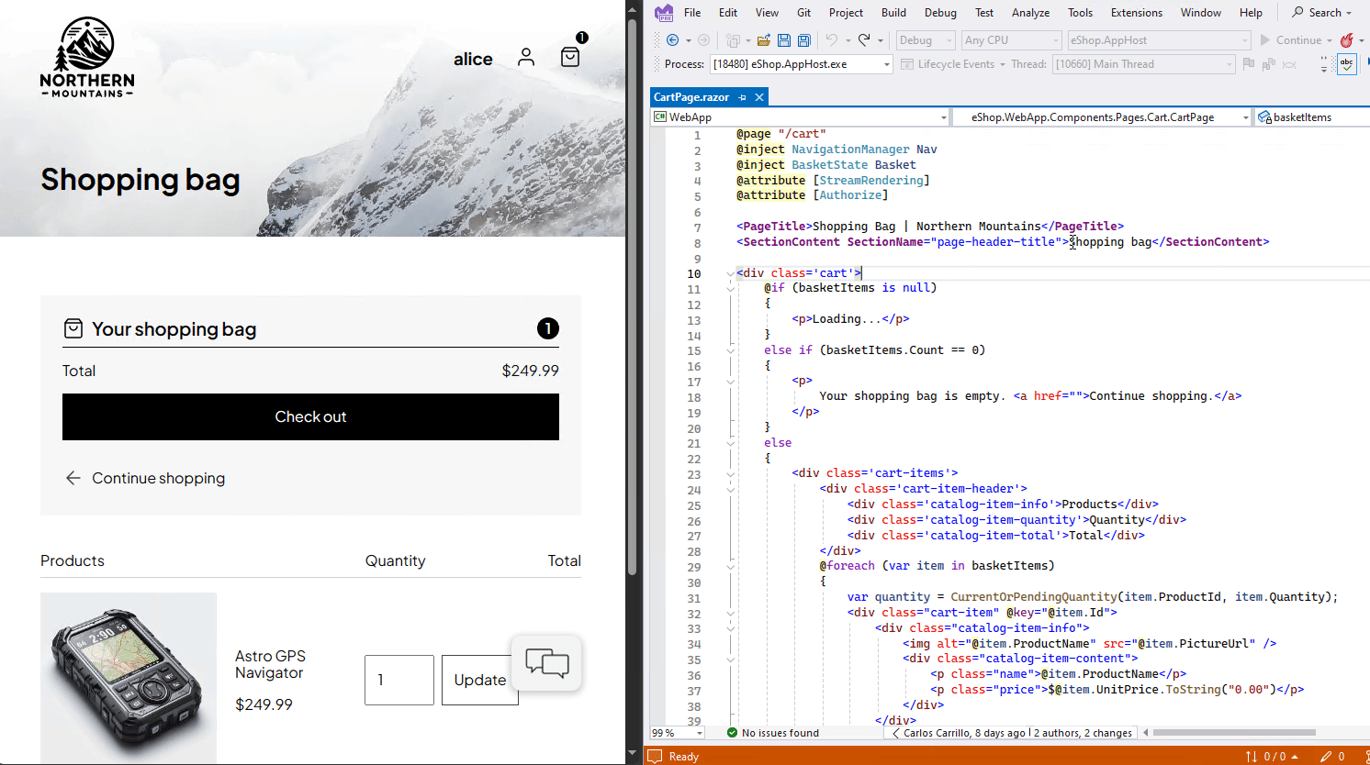
Technology : Visual Studio
Hot Reload :
Accelerated Development: Hot reload reduces rebuild and deployment time, speeding up the development process.
Efficient Code Changes: Developers can see immediate results of code modifications without the need for full rebuilds or deployments.
Enhanced Support: Visual Studio 2022 improves hot reload functionality, particularly benefiting Blazor and Razor editors.
CSS Integration: Hot reload now supports changes made in CSS files, providing a seamless development experience across different code types.
Benefits of this feature to developer:
Instant Feedback: See code changes immediately.
Boosted Productivity: Less wait time means more work done.
Efficient Workflow: Change code on-the-fly for faster iteration.
Better User Experience: Quick updates lead to smoother apps.
Team Collaboration: Share and review changes instantly.

Slide 8
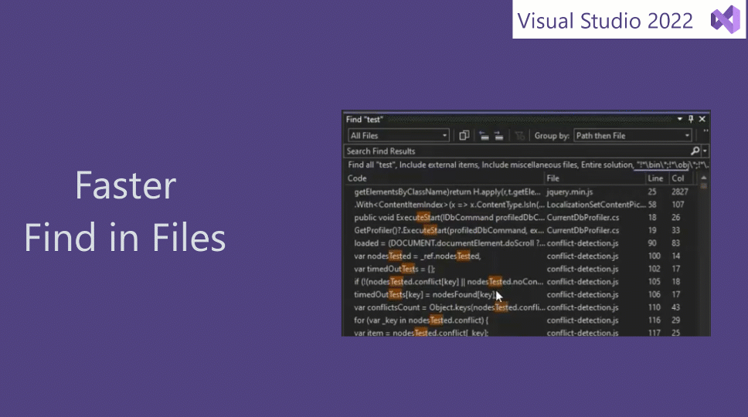
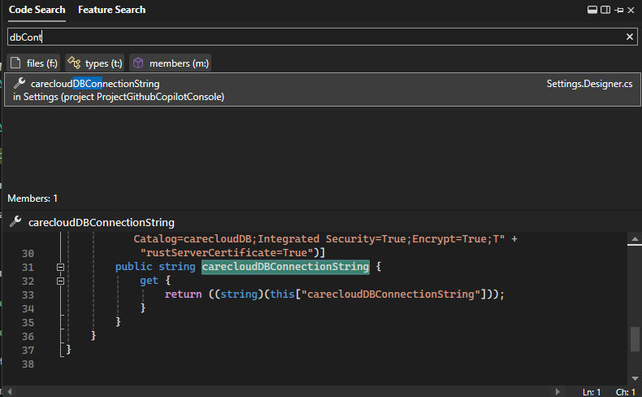
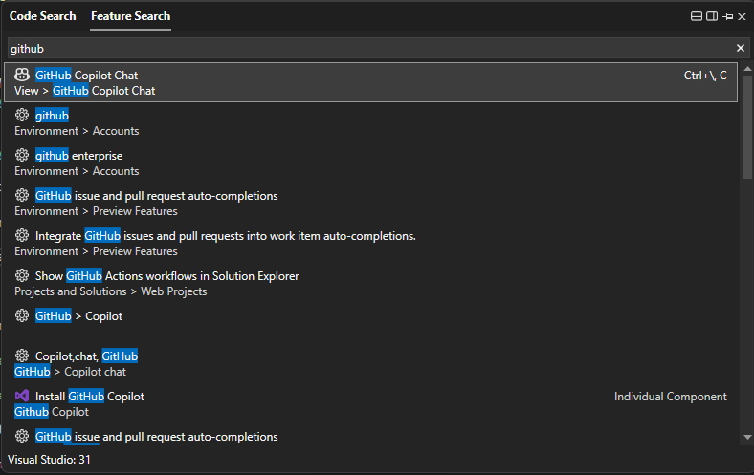
Technology : Visual Studio
Find in Files is faster :
Visual Studio's "Find in Files" feature facilitates searching for specific files within a project.
The latest version of Visual Studio boasts significant enhancements to the performance of this feature.
The performance improvement is remarkable, with the new version being three times faster than its predecessors.
Two types of searches : Code Search (Ctrl+T) and Feature Search (Ctrl+Q)
Benefits of this feature to developer:
Faster search performance boosts productivity by reducing wait times.
Quick file access enables efficient navigation in codebases.
Improved file search streamlines development workflows.
Significant time savings result from the speed enhancement, allowing more focus on coding.

Slide 9
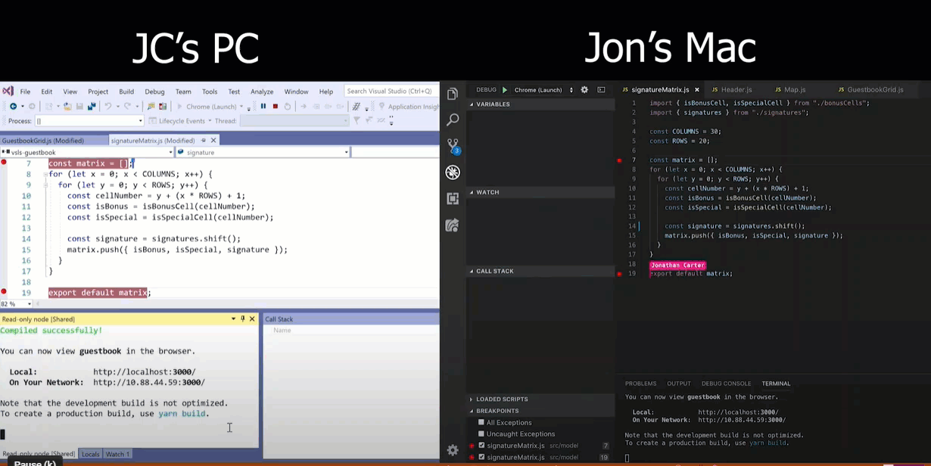
Technology : Visual Studio
Clone a Repository :
Get code from online repository like GitHub or Azure DevOPS & clone it in Visual Studio.
AI-Assisted Development:
With a subscription to GitHub Copilot, you can get answers to questions and consult with an AI while you code. To use GitHub Copilot in Visual Studio, you must have Visual Studio 2022 version 17.6 or later installed. For GitHub Copilot in Visual Studio Code, version 1.77 or later is required.
Git Tooling is Faster:
You can create a pull request from the Visual Studio IDE. Also, try the new summary view for diffs, to make it easier to focus on what changed.
Performance Improvement:
Solution Load is up to 8x faster
Solution close is up to 50% faster
.NET build time is reduced by 80%
Decompilation 10x faster
Code Coverage is 35% faster
Real Time Collaboration:
Live share also get upgraded in Visual Studio 2022. To improve real time collaboration , live share now features integrated text chats. Devs can collaborate, exchange ideas, pair programming & review code using the newly integrated text chat.

Slide 10
Technology : Visual Studio
Feature | Visual Studio 2019 | Visual Studio 2022
Shared Benefits | New home screen, code sharing (Live Share), easier code refactoring. | Same as 2019, with additional benefits i.e AI-powered IntelliSense, Live Share, Simplified Git integration, and Automatic CI/CD setup
Code Editing | Intellicode for C# | Intellicode for multiple languages i.e C++ ,Java, SQL , Python.
Debugging | Basic debugging features | Simplified decompiling for local and remote debugging
User Interface (UI) | Limited customization options | More customization options, document management system
Accessibility | Basic accessibility features | Improved access features and extension overview
C++ Support | C++ 17 tools | C++ 20 tools
Performance | Standard weight, 32-bit application | Lightweight, 64-bit application
Memory | Limited to 4 GB | Significantly more memory

Slide 11
Technology : Visual Studio
New Debugger Features in Visual Studio 2022
These are additional functionalities and enhancements introduced in the debugger tool of Visual Studio 2022, aiming to provide developers with improved debugging capabilities and efficiency during the software development process.
Temporary Breakpoints
Dependent Breakpoints
Conditional Breakpoints
Force Run to cursor
External Sources
Attach Process / Select Process by Window
Debug faster with IntelliTrace

Slide 12
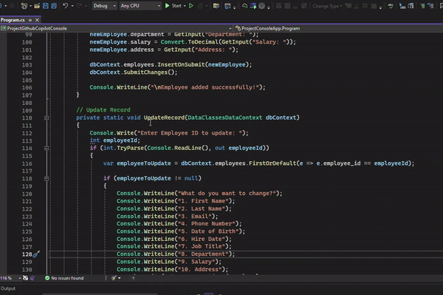
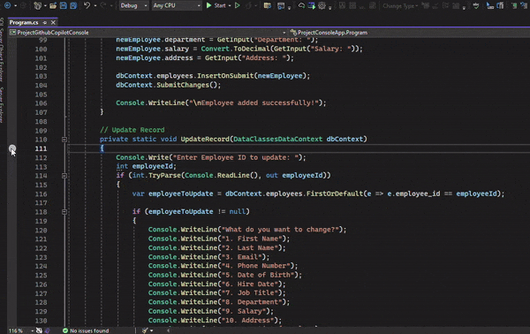
Technology : Visual Studio
New Debugger Features in Visual Studio 2022
Temporary Breakpoints :
Temporary breakpoints are breakpoints that are automatically removed once they are hit during debugging.
They can be set by right-clicking on the left margin of the code editor or by clicking on the margin directly.
You can make a breakpoint temporary by setting its hit count to "Only once" in the breakpoint settings.
Before
After

Slide 13
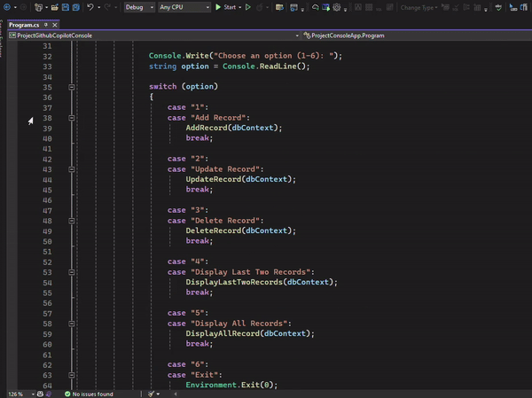
Technology : Visual Studio
New Debugger Features in Visual Studio 2022
Dependent Breakpoints :
Dependency: Dependent breakpoints in Visual Studio rely on the state or execution of other breakpoints.
Usage: Dependent breakpoints are handy for debugging intricate logic or scenarios requiring coordinated breakpoint activation.

Slide 14
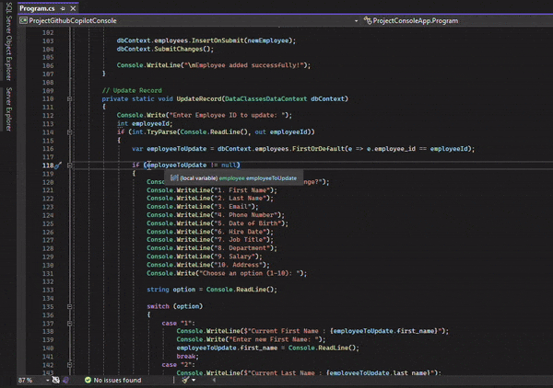
Technology : Visual Studio
New Debugger Features in Visual Studio 2022
Conditional Breakpoints:
Conditional breakpoints in Visual Studio 2022 allow you to specify conditions for when a breakpoint should be hit during debugging.
Instead of breaking every time the line is reached, the breakpoint only triggers if the condition you set evaluates to true.

Slide 15
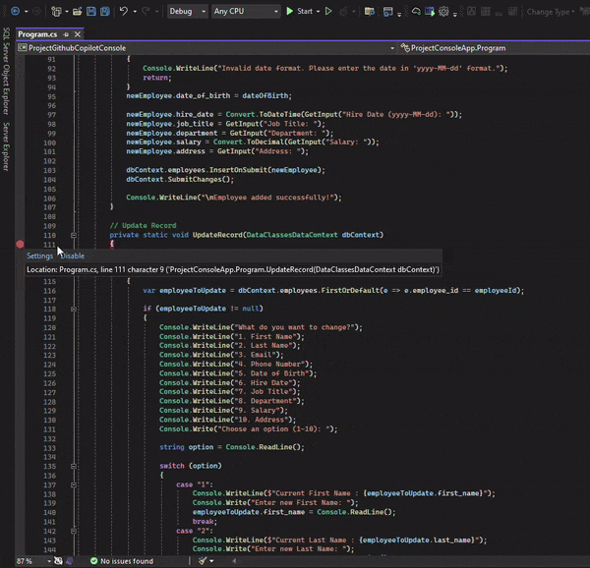
Technology : Visual Studio
New Debugger Features in Visual Studio 2022
Force Run to Cursor:
In Visual Studio 2022, "Force Run to Cursor" refers to the action of directing the debugger to execute the program until it reaches the line of code where the cursor is positioned, bypassing all intermediate code execution.
This feature accelerates debugging by allowing developers to swiftly navigate to a specific point in their code for inspection or analysis.

Slide 16
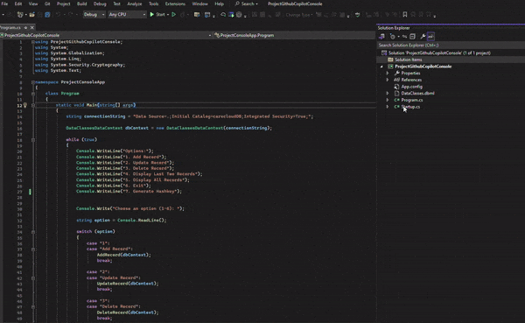
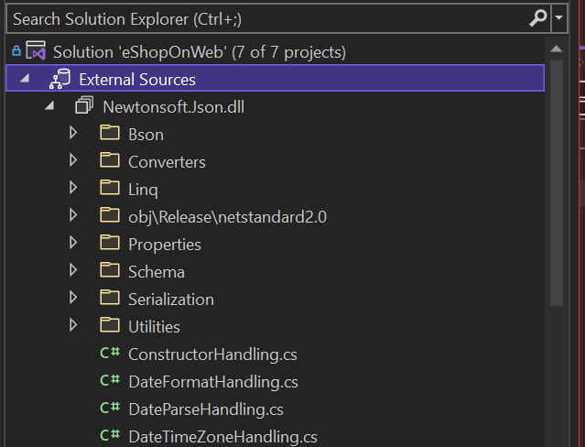
Technology : Visual Studio
New Debugger Features in Visual Studio 2022
External Sources
The feature adds a new top-level node to Solution Explorer, which appears when you are in a debugging session
It provides a convenient way to browse and access source files from external modules, aiding in debugging processes involving multiple external libraries or frameworks.

Slide 17
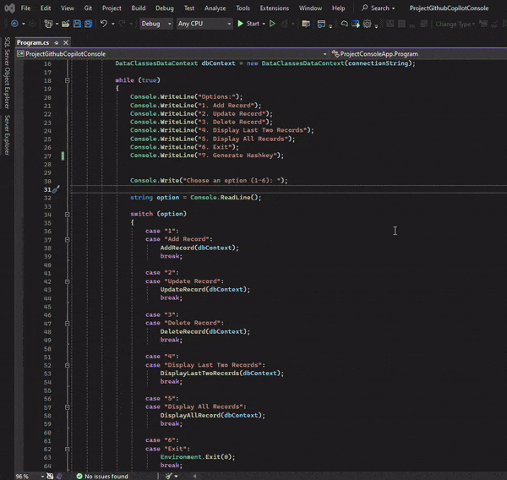
Technology : Visual Studio
New Debugger Features in Visual Studio 2022
Attach Process / Select Process by Window
The "Attach to Process“ (Ctrl + Alt + P) dialog box in Visual Studio 2022 allows you to connect the debugger to an existing running process.
This feature enables you to inspect and debug code execution within external applications or processes, even if they were not started from within Visual Studio.
By attaching the debugger, you gain access to debugging tools and capabilities to analyze the behavior of the process, set breakpoints, inspect variables, and diagnose issues effectively.

Slide 18
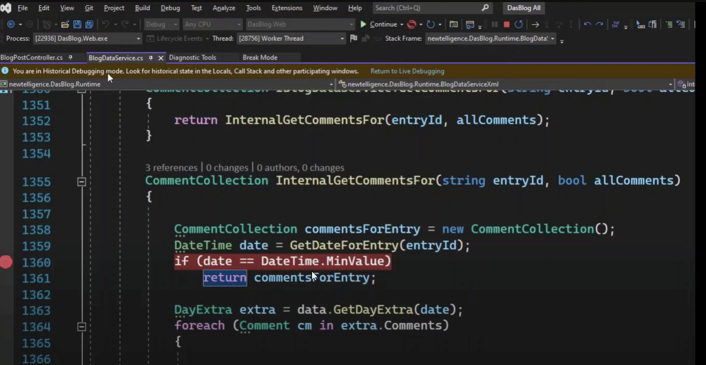
Technology : Visual Studio
New Debugger Features in Visual Studio 2022
Debug Faster with IntelliTrace in Visual Studio 2022
IntelliTrace: It's a debugging tool in Visual Studio that records program execution details.
Availability : It is available in Visual Studio Enterprise Version.
Fast Debugging: IntelliTrace allows developers to quickly debug issues by providing detailed historical data. The debugger controls such as stepping into (F11), stepping over (F10), and stepping out (Shift + F11).
Time Travel Debugging: Developers can step back in time during debugging sessions to explore previous states of the application.
Event Collection: IntelliTrace captures events, exceptions, method calls, and other runtime information.
Advanced Analysis: It offers deep insights into application behavior and helps in pinpointing bugs effectively.
Integrated Tool: IntelliTrace seamlessly integrates into Visual Studio, making debugging more convenient for developers.

Slide 19
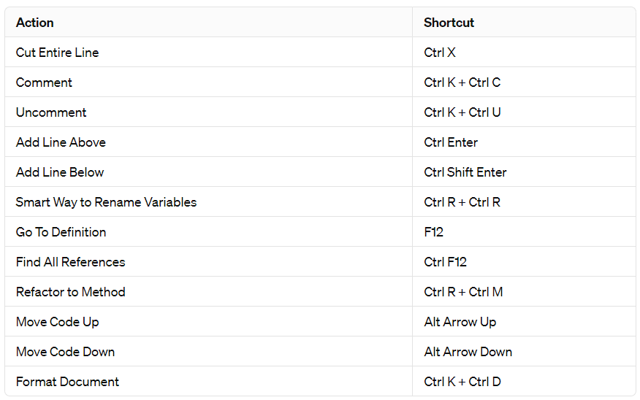
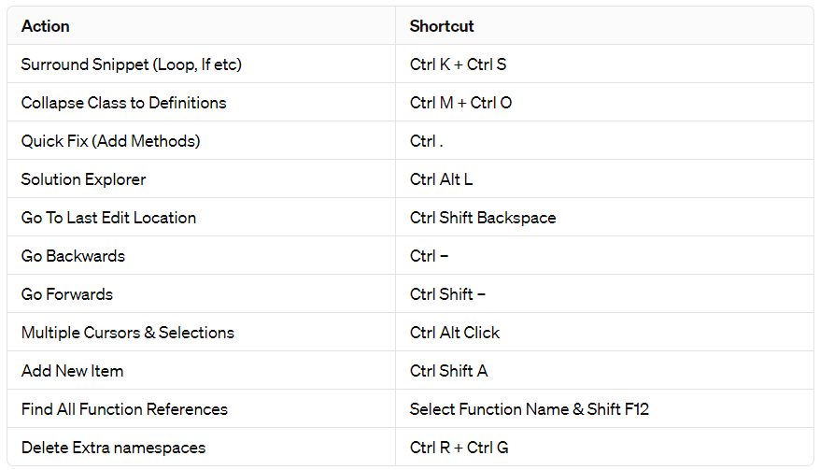
Technology : Visual Studio
Useful Shortcuts to Code Faster with Visual Studio 2022

Slide 20
Thankyou

