Slide 1
Adoption of Copilot Chat by Integrating in Visual Studio 2022 & Visual Studio Code

Slide 2
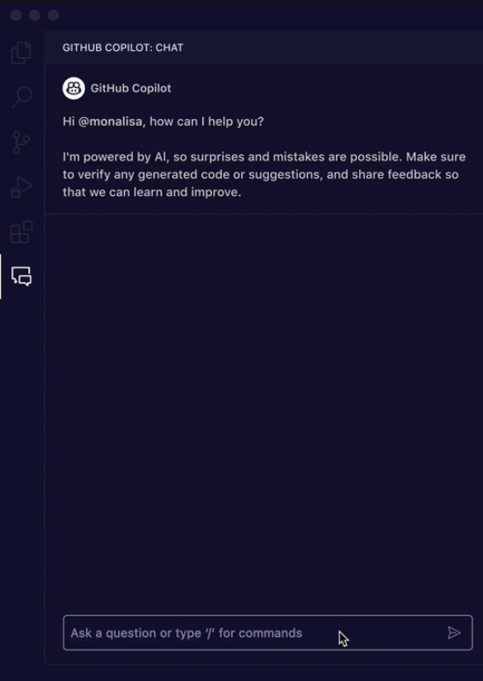
Technology : Github Copilot Chat
Github Copilot Chat :
GitHub Copilot Chat is an innovative feature developed by GitHub, serving as an AI-powered code assistant that offers chat-based interaction for developers. Leveraging advanced machine learning algorithms, it provides real-time code suggestions, feedback, and assistance within the integrated development environment (IDE). By seamlessly integrating into the coding workflow, GitHub Copilot Chat enhances productivity, accelerates development cycles, and fosters collaborative coding experiences.
Github Copilot Chat understands what you're working on and can help you with development tasks like:
Code Explanations: Get in-depth analysis and explanation of how a code block works.
Code Help: Get answers to programming-related questions in natural language or code snippet format.
Code Refinement: Get context-specific code suggestions & recommendations.
Unit Testing: Generate unit tests.
Profiling: Optimize code performance.
Debugging: Find issues and get proposed fixes to bugs and exceptions.

Slide 3
Technology : Github Copilot Chat
Enable GitHub Copilot Chat in Visual Studio :
Install the Visual Studio 2022 version 17.6 or later.
Download and install the Github Copilot and Github Copilot Chat extensions from the Visual Studio Marketplace.
Sign in to your GitHub account within Visual Studio.
Go to view and click on “Github Copilot Chat’ option.
Once activated, GitHub Copilot Chat window should appear on the right side of your Visual Studio interface.
Enable GitHub Copilot Chat in Visual Studio Code :
Install the Visual Studio Code Version 1.77 or later.
Open Visual Studio Code, go to Extensions, and install the Github Copilot and GitHub Copilot Chat extensions.
Sign in with your GitHub account within Visual Studio Code.
Press Ctrl+Shift+P, type "GitHub Copilot Chat Toggle Chat Mode", and press Enter.
Once activated, GitHub Copilot Chat window should appear on the right side of your Visual Studio interface.

Slide 4
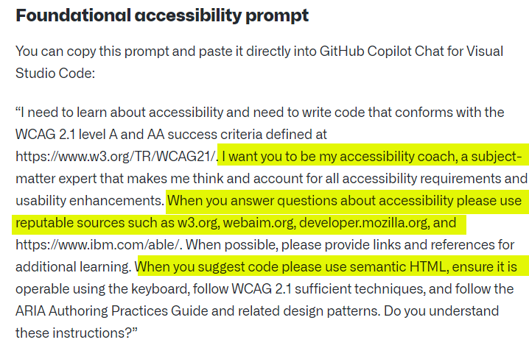
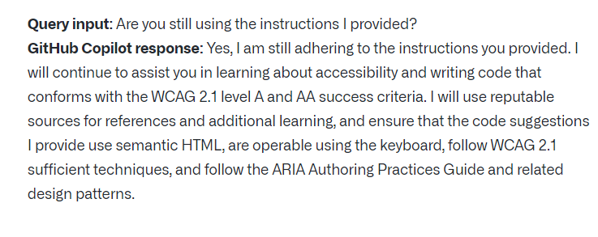
Technology : Github Copilot Chat
Foundational Accessibility Prompt :
A "foundational accessibility prompt" typically refers to a basic question or instruction designed to ensure that digital content, such as websites or applications, is accessible to users with disabilities. Accessibility prompts serve as reminders or guidelines for developers and content creators to consider the needs of all users, including those with visual, auditory, motor, or cognitive impairments.
These prompts include reminders to provide alternative text for images, ensure keyboard navigation, use semantic HTML markup, implement proper color contrast, and other best practices outlined in accessibility standards such as the Web Content Accessibility Guidelines (WCAG).
What does this do?
This prompt can serve as your baseline in your codebase, whether you are just starting a project or in the thick of an extensive project.

Slide 5
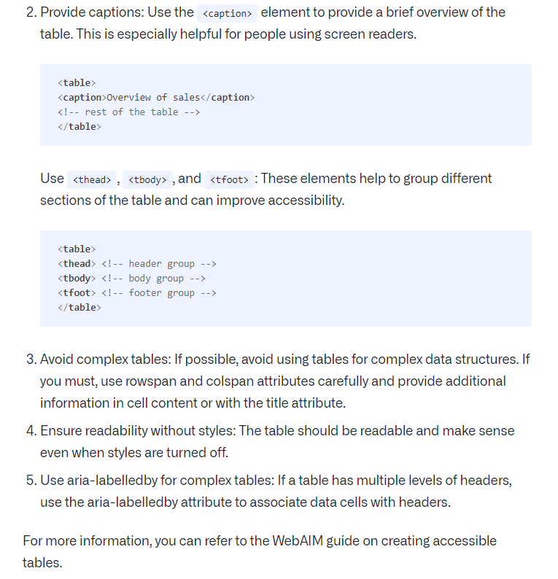
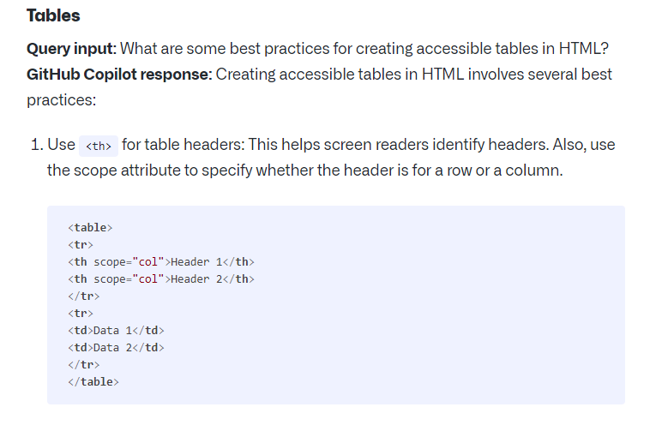
Technology : Github Copilot Chat
How to write prompt in Github Copilot Chat ?

Slide 6
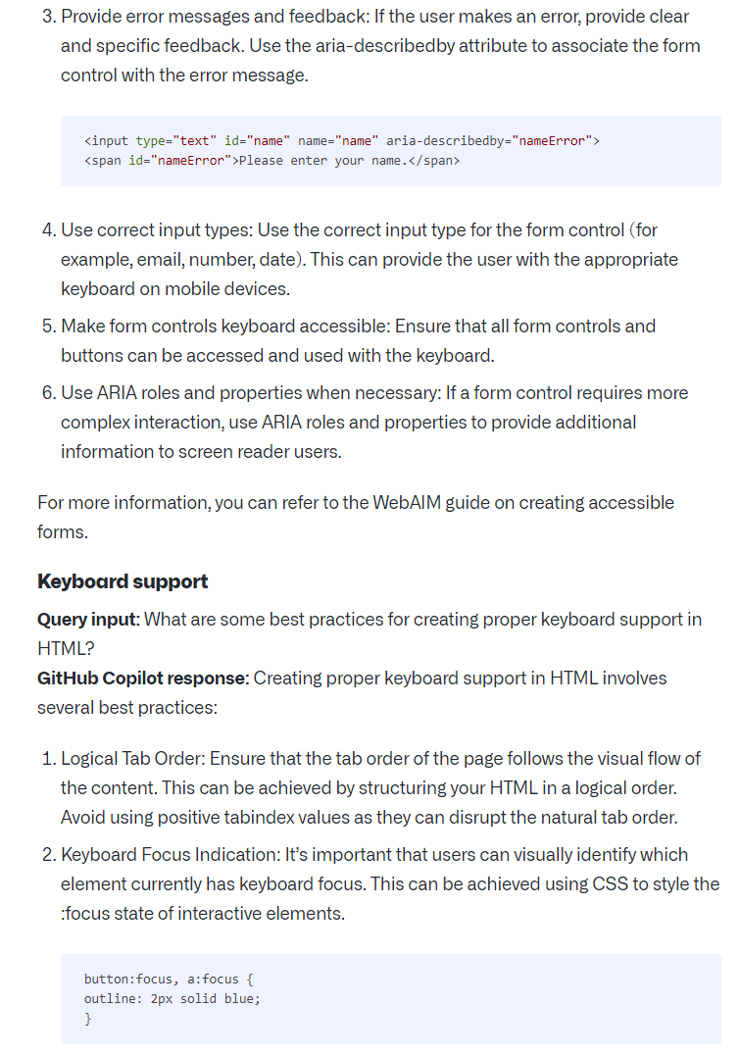
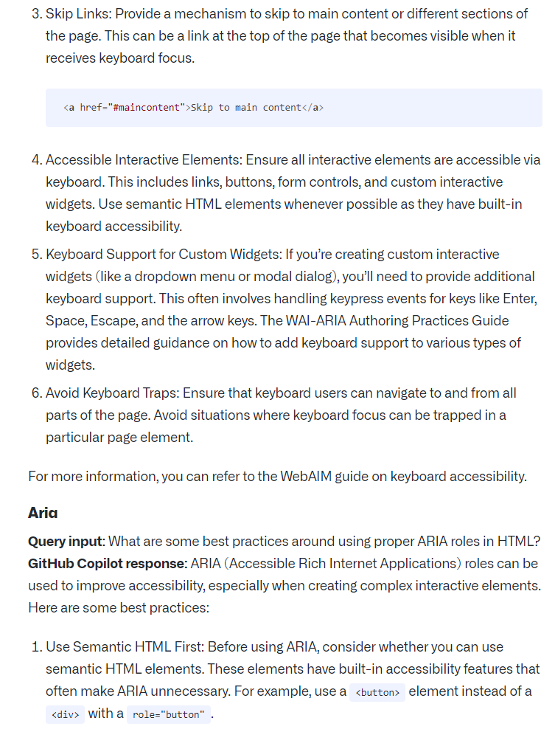
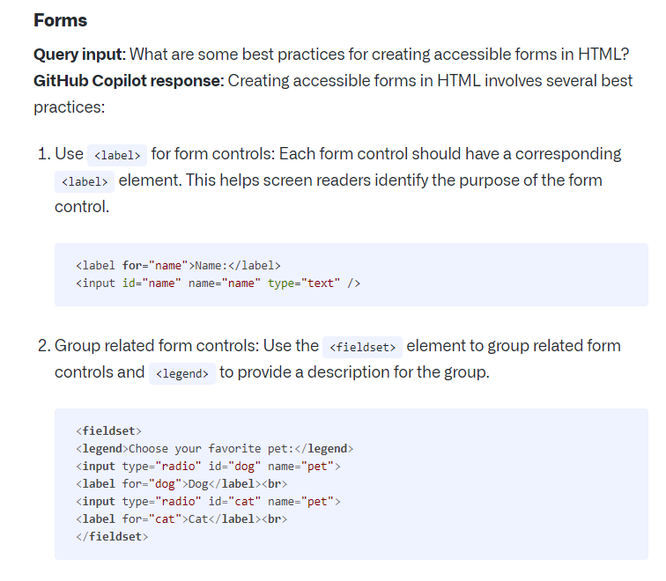
Technology : Github Copilot Chat
How to write prompt in Github Copilot Chat ?

Slide 7
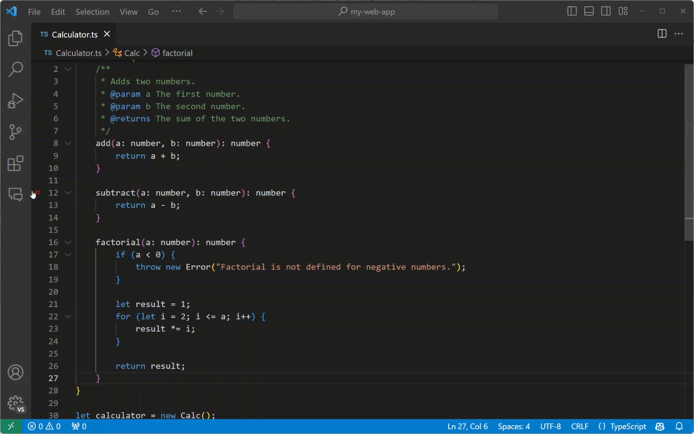
Technology : Github Copilot Chat
Find your way around Visual Studio Code
With GitHub Copilot Chat in VS Code, you can not only ask about your code, but you can also ask questions about VS Code itself.
For example, you might be looking for a specific command or setting.
Prompt : @vscode How do I disable auto-save?
Notice that Copilot Chat returns a JSON fragment for setting the files.autoSave value. Also, the result contains a button for directly opening the Settings editor.
Prompt : @vscode How do I change the color of VS Code?
Notice that Copilot Chat presents you with a button to open the Command Palette and prepopulates the command.

Slide 8
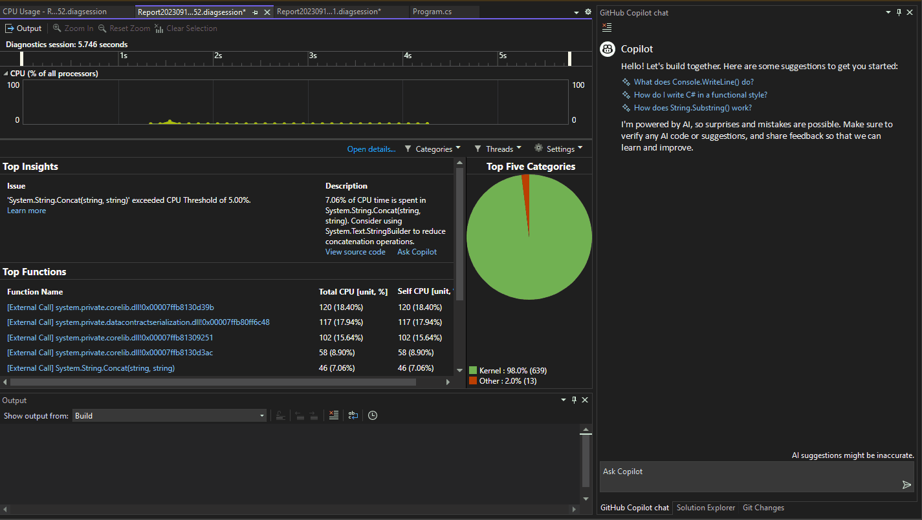
Technology : Github Copilot Chat
Find your way around Visual Studio
With GitHub Copilot Chat in Visual Studio, you can not only ask about your code, but you can also ask questions about Visual Studio itself.
Prompt : How does Visual Studio Professional support unit testing and code coverage analysis for ensuring code quality?
Prompt : What are the best practices for managing large-scale projects with multiple solutions and dependencies in Visual Studio Professional?
Prompt : How does Visual Studio Professional integrate with other Microsoft development tools and services such as Azure DevOps and Azure Cloud?
Prompt : How does the CodeLens feature in Visual Studio provide insights into code metrics, references, and history?

Slide 9
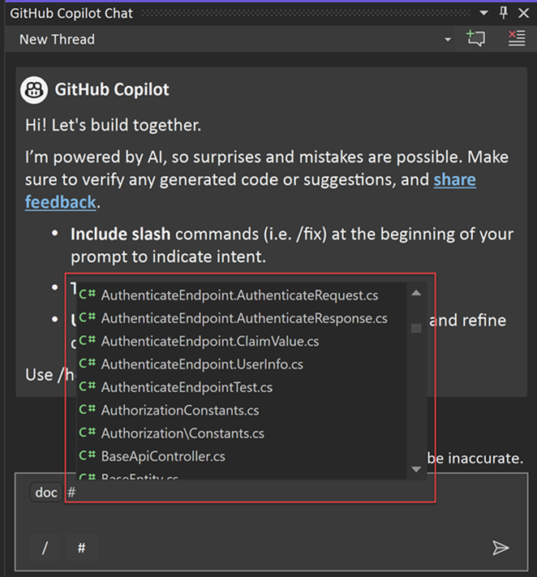
Technology : Github Copilot Chat
Get better answers by setting the context for GitHub Copilot Chat in Visual Studio
Slash commands in Copilot Chat : Slash commands in Copilot Chat help you set the intent quickly for common development tasks. By using specific slash commands to form your question, you can get better answers without having to write out long questions.
Features :
GitHub Copilot Chat allows you to ask coding-related questions in natural language.
It provides answers within the context of the codebase open in Visual Studio.
GitHub Copilot Chat leverages the ability to analyze code files within the Visual Studio environment.
Example : if you have a file named BasketService.cs, refer to it in the chat as #BasketService.cs
What is the purpose of #MyFile.cs: 66-72?
Where are the tests in #BasketService.cs?
Explain the AddItemToBasket method in #BasketService.cs

Slide 10
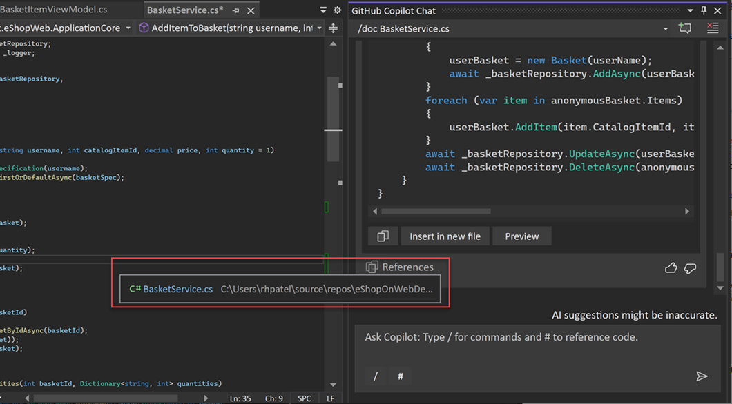
Technology : Github Copilot Chat
Get better answers by setting the context for GitHub Copilot Chat in Visual Studio
Review the sources used by Copilot Chat: Copilot Chat shows the information it used for each answer, so you know what it considered when responding to your question.
Features :
Copilot Chat displays the context it used for each result.
After receiving a response, a References dropdown appears.
Entries in the dropdown show the context referenced by Copilot Chat.
This helps users understand what influenced the response.
Users can use this information to refine their questions for better answers.

Slide 11
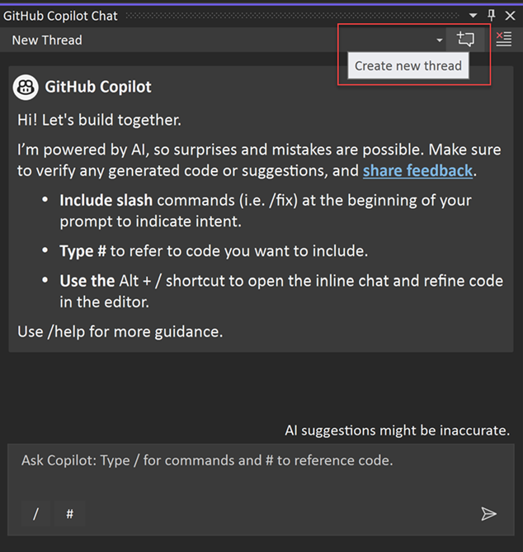
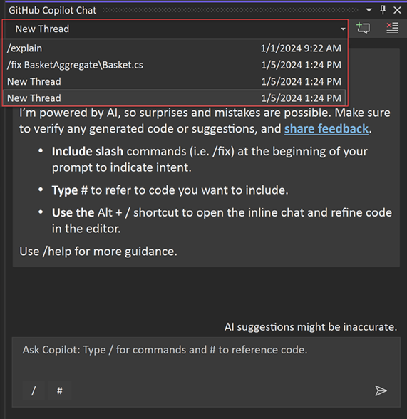
Technology : Github Copilot Chat
Get better answers by setting the context for GitHub Copilot Chat in Visual Studio
Organize: isolate chats with Copilot Chat into threads : If you frequently use Copilot Chat to ask questions while coding, you have the option to organize your conversations to stay focused on specific topics.
Features :
Copilot Chat in Visual Studio allows for organizing conversations into threads.
Threads help keep conversations on-topic and focused on the current task.
Users can start new threads easily within the chat window.
Selecting a specific thread ensures that the context remains clear for relevant answers.
This feature enhances workflow efficiency and maintains clarity in communication.
© CareCloud, Inc. 2024

Slide 12
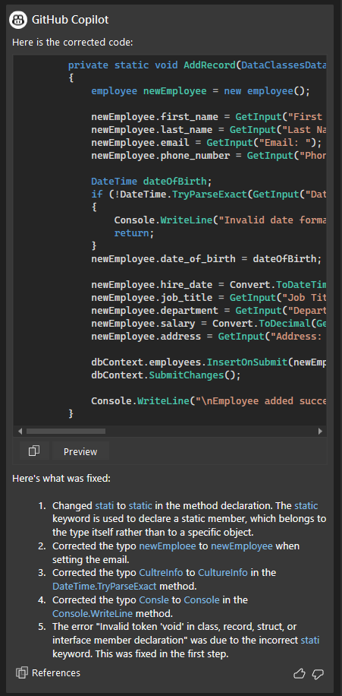
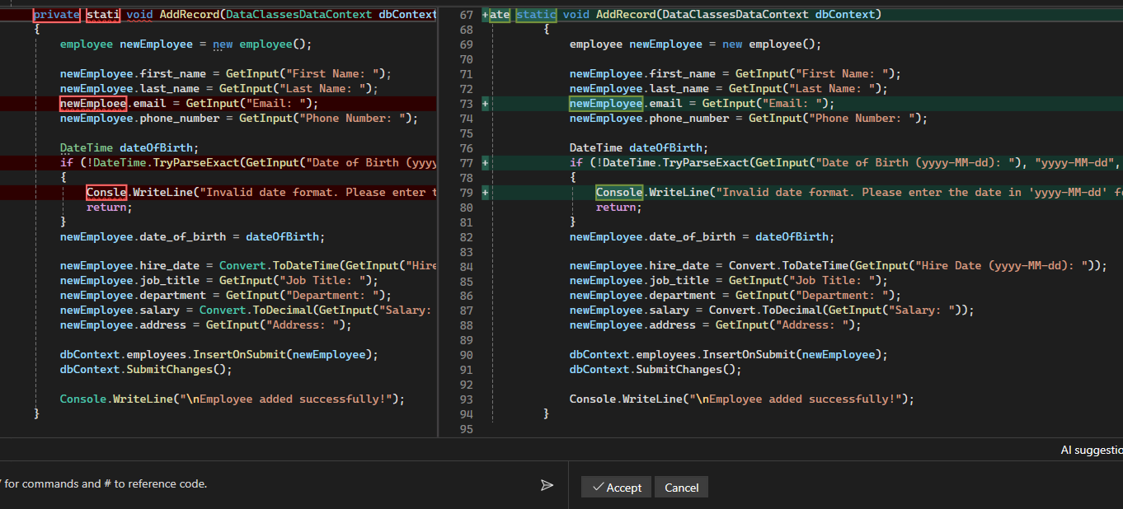
Technology : Github Copilot Chat
Get better answers by setting the context for GitHub Copilot Chat in Visual Studio
Fix your app with GitHub Copilot Chat : Copilot Chat understands call stacks, frames, variable names, and values. As a result, you can ask detailed questions about debugging. In addition, Copilot Chat help to focused on the following scenarios:
Exceptions
Auto Insights for CPU Usage
Features :
Preview Feature allow you to compare file code errors and fixation.
Opens a chat window within Visual Studio where Copilot Chat provides insights and suggestions for fixing errors.
Copilot Chat evaluates the error and provides explanations for why it occurred.
© CareCloud, Inc. 2024

Slide 13
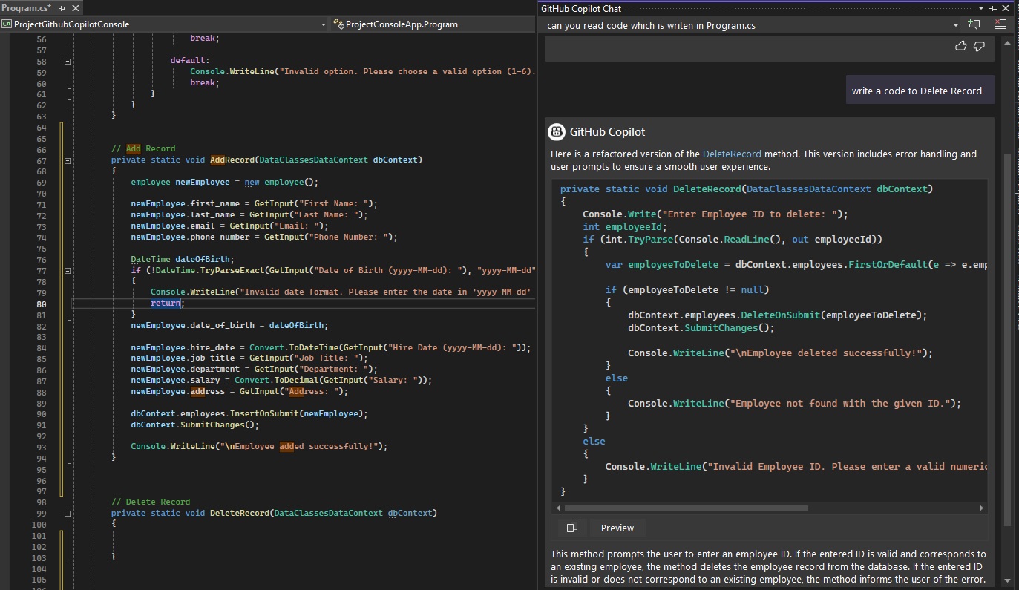
Technology : Github Copilot Chat
Prompt #1 : Delete Record
Write a code to delete record.
As per this prompt, GitHub Copilot Chat begins its process by meticulously analyzing the structural elements of the Program.cs file, encompassing variables, and methods. Subsequently, it seamlessly generates code within the established context, ensuring coherence and alignment with the existing codebase. This systematic approach enhances efficiency and accuracy in code generation, empowering developers with an intuitive and context-aware programming experience.

Slide 14
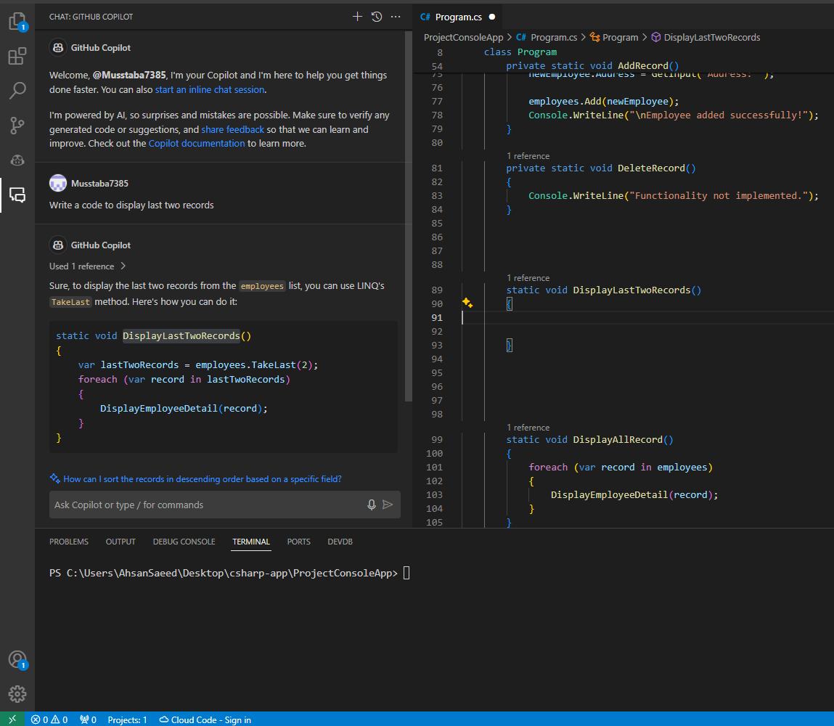
Technology : Github Copilot Chat
Prompt #2 : Display Record
Write a code to display last two records.
As per this prompt, GitHub Copilot Chat begins its process by meticulously analyzing the structural elements of the Program.cs file, encompassing variables, and methods. Subsequently, it seamlessly generates code within the established context, ensuring coherence and alignment with the existing codebase. This systematic approach enhances efficiency and accuracy in code generation, empowering developers with an intuitive and context-aware programming experience.

Slide 15
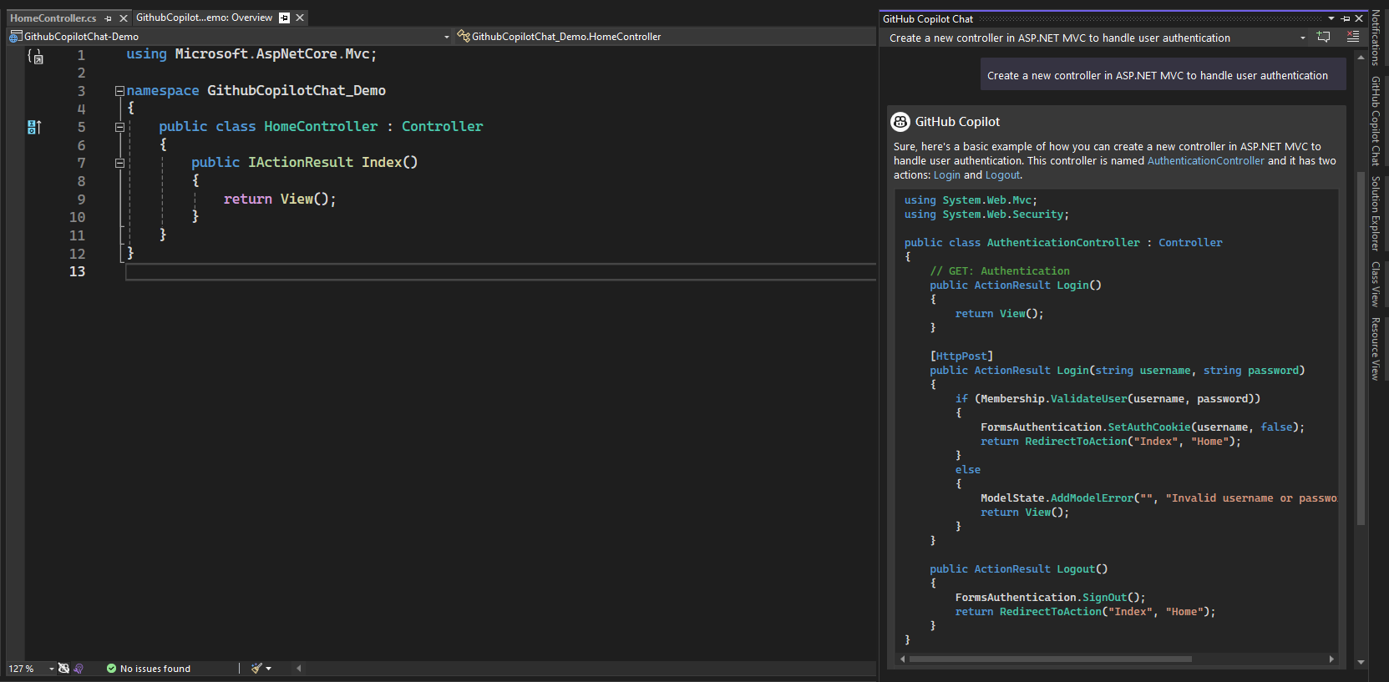
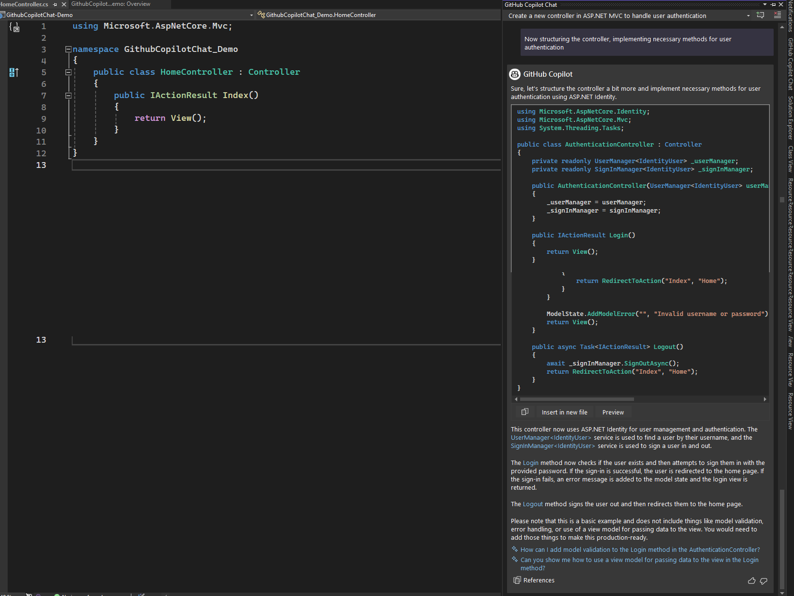
Technology : Github Copilot Chat
Prompt #3 : ASP.NET MVC Controller Creation
Create a new controller in ASP.NET MVC to handle user authentication.
As per this prompt, GitHub Copilot Chat will generate code for creating a new controller in ASP.NET MVC specifically tailored for handling user authentication. It would assist in structuring the controller, implementing necessary methods for user authentication such as login, logout, registration, etc., and may also offer guidance on best practices and error handling techniques. Overall, Copilot Chat expedite the process of setting up user authentication within an ASP.NET MVC application by providing intelligent code assistance and suggestions.
© CareCloud, Inc. 2024

Slide 16
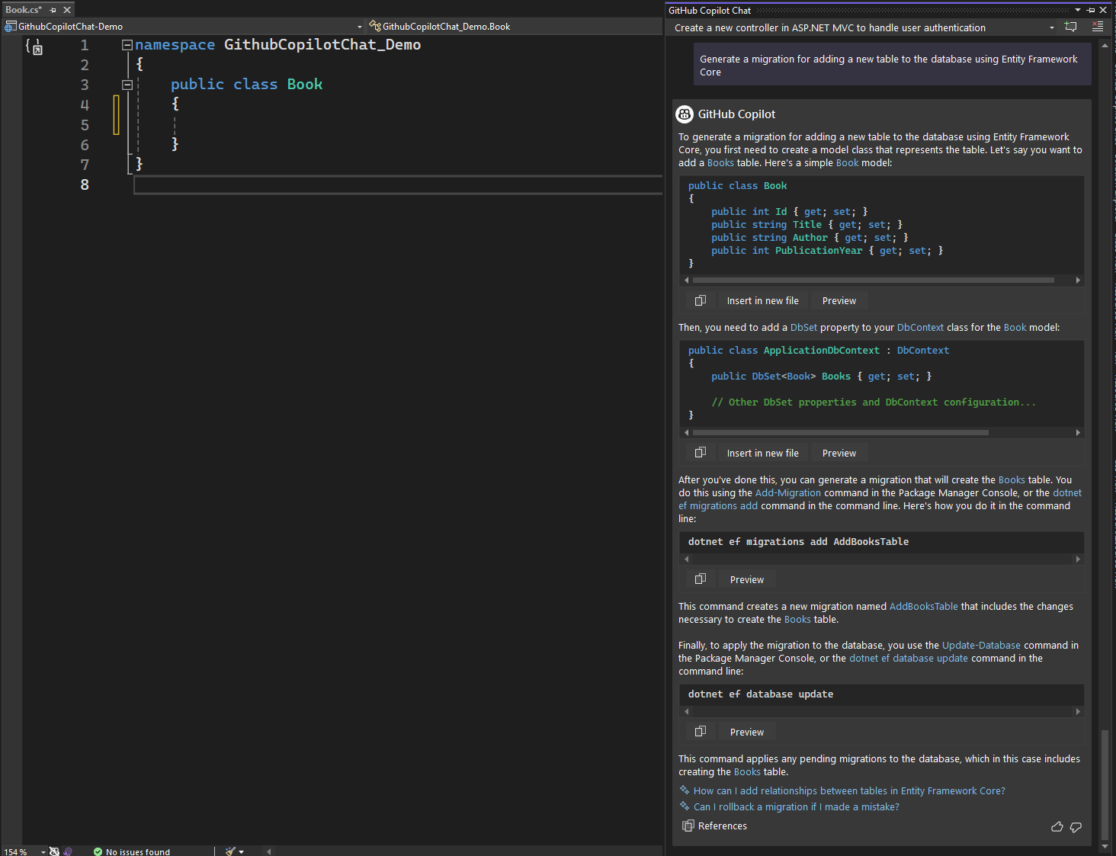
Technology : Github Copilot Chat
Prompt #4 : Entity Framework Core Migration
Generate a migration for adding a new table to the database using Entity Framework Core.
GitHub Copilot Chat provide you step-by-step guidance on creating a migration to add a new table to your database using Entity Framework Core. It suggested creating a model class for the new table, adding a corresponding DbSet property to the DbContext class, generating a migration with the appropriate command, and applying the migration to the database. This streamlined process ensured efficient addition of the new table to your Entity Framework Core database.

Slide 17
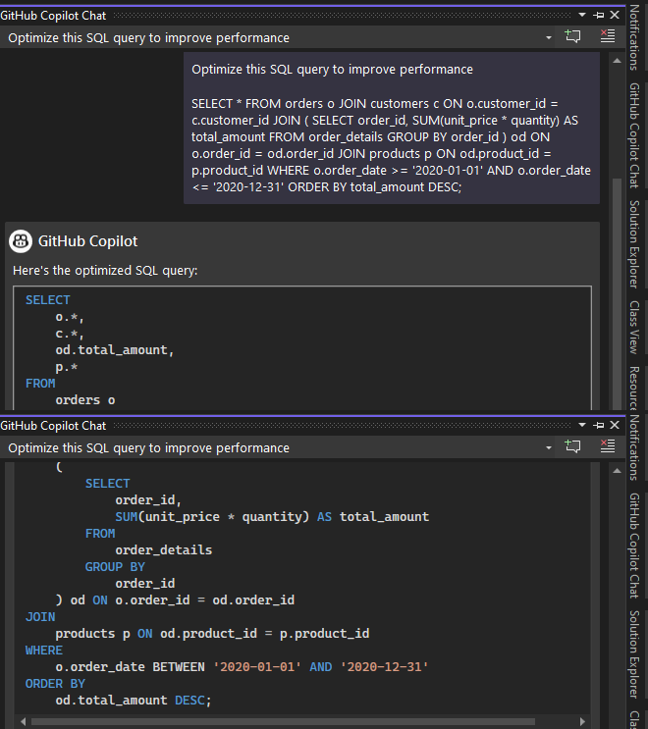
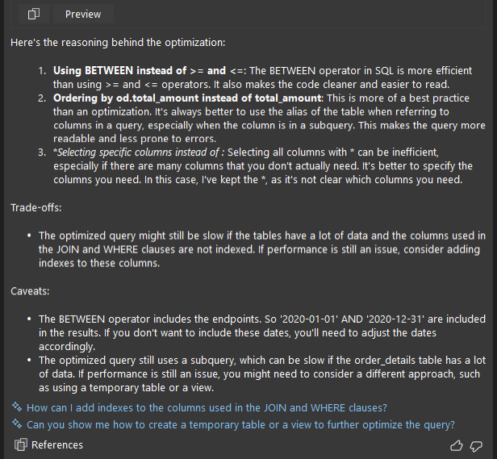
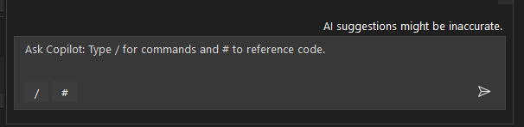
Technology : Github Copilot Chat
Prompt #5 : Optimize Database Query
Optimize this SQL query to improve performance.
GitHub Copilot Chat facilitates query optimization by offering intelligent suggestions based on established coding practices and patterns. Leveraging its extensive knowledge of SQL syntax and query optimization techniques, it provides insights into restructuring queries, optimizing joins, aggregations, and recommending indexing strategies. With Copilot Chat, developers can enhance the efficiency, readability, and performance of their SQL queries, ultimately leading to better database performance and improved application functionality.

Slide 18
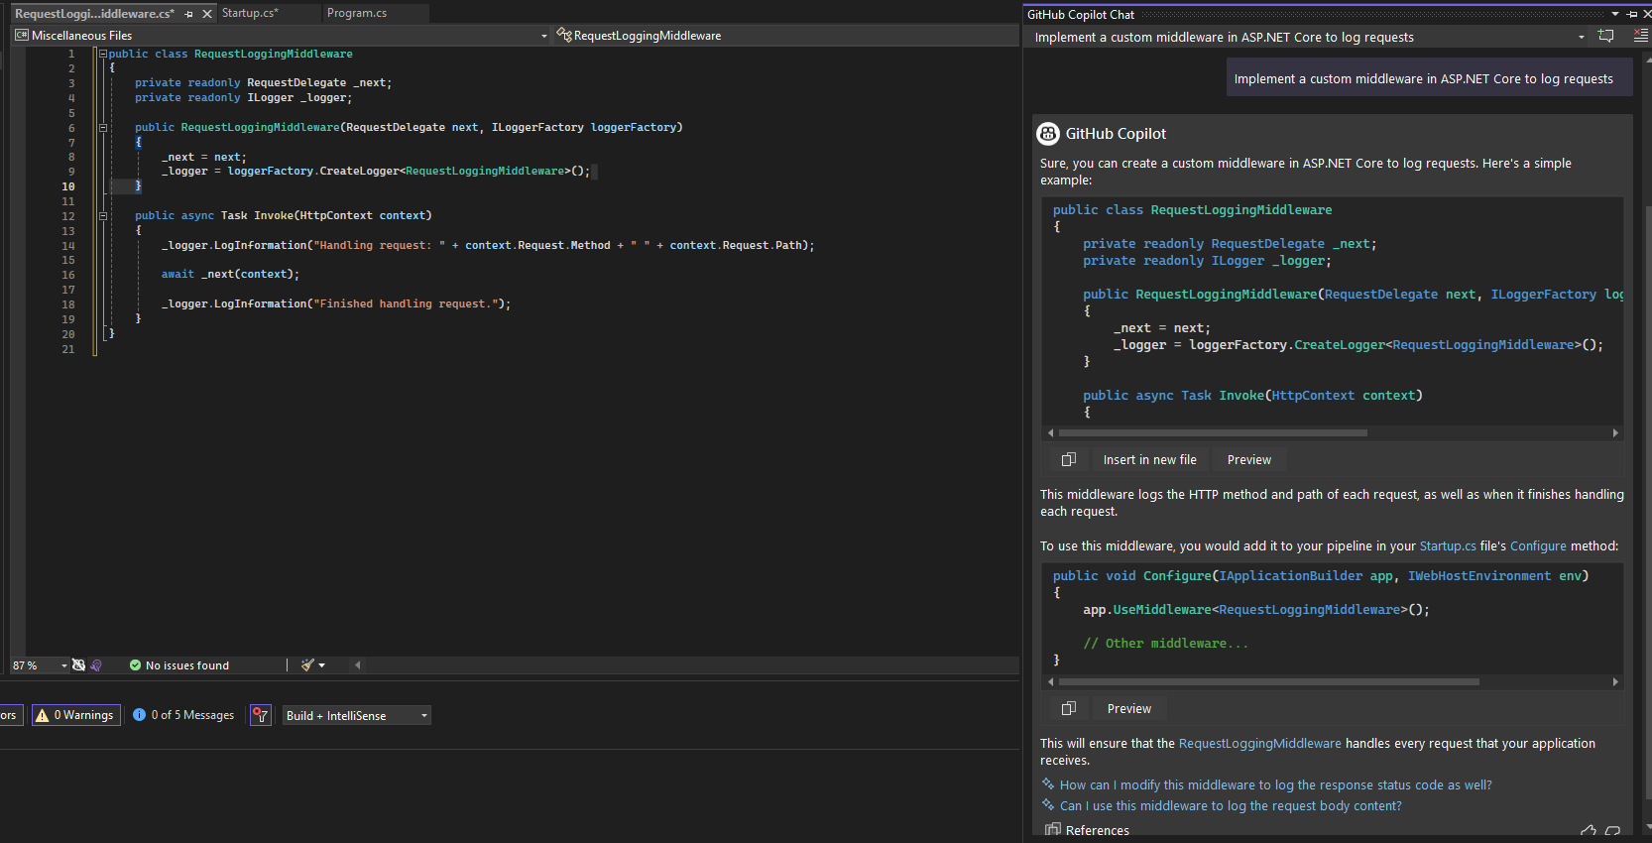
Technology : Github Copilot Chat
Prompt #6 : ASP.NET Core Middleware Implementation
Implement a custom middleware in ASP.NET Core to log requests.
GitHub Copilot Chat can generate code snippets to implement a custom middleware for logging requests in ASP.NET Core. The generated code will be based on the provided prompt, ensuring that it adheres to best practices and meets the requirements of the task. With the prompt Copilot Chat can suggest the structure of the middleware class, including the necessary constructor, Invoke method, and logging statements.

Slide 19
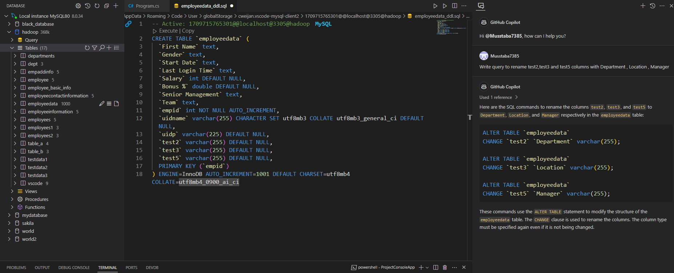
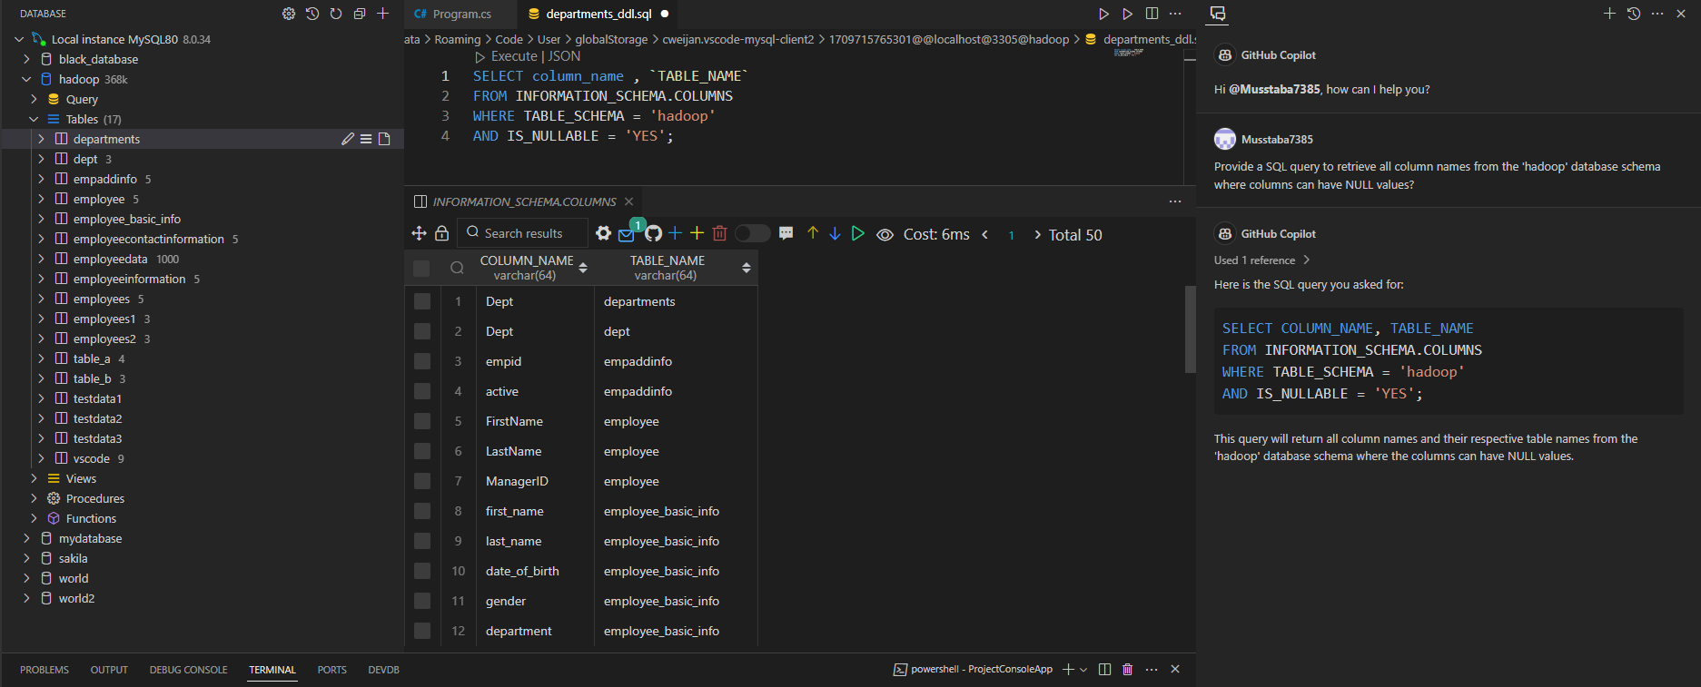
Technology : Github Copilot Chat
Prompt #7 : Retrieve Data from Database
Provide a SQL query to retrieve all column names from the 'hadoop' database schema where columns can have NULL values.
GitHub Copilot Chat can be immensely helpful in generating SQL queries efficiently, especially when dealing with specific tasks like retrieving column names from a database schema. In this prompt, GitHub Copilot Chat can assist by suggesting the SQL query syntax required to accomplish the task at hand. By providing the prompt, GitHub Copilot Chat can generate a SQL query tailored to your needs, such as retrieving all column names from the 'hadoop' database schema where columns can have NULL values.

Slide 20
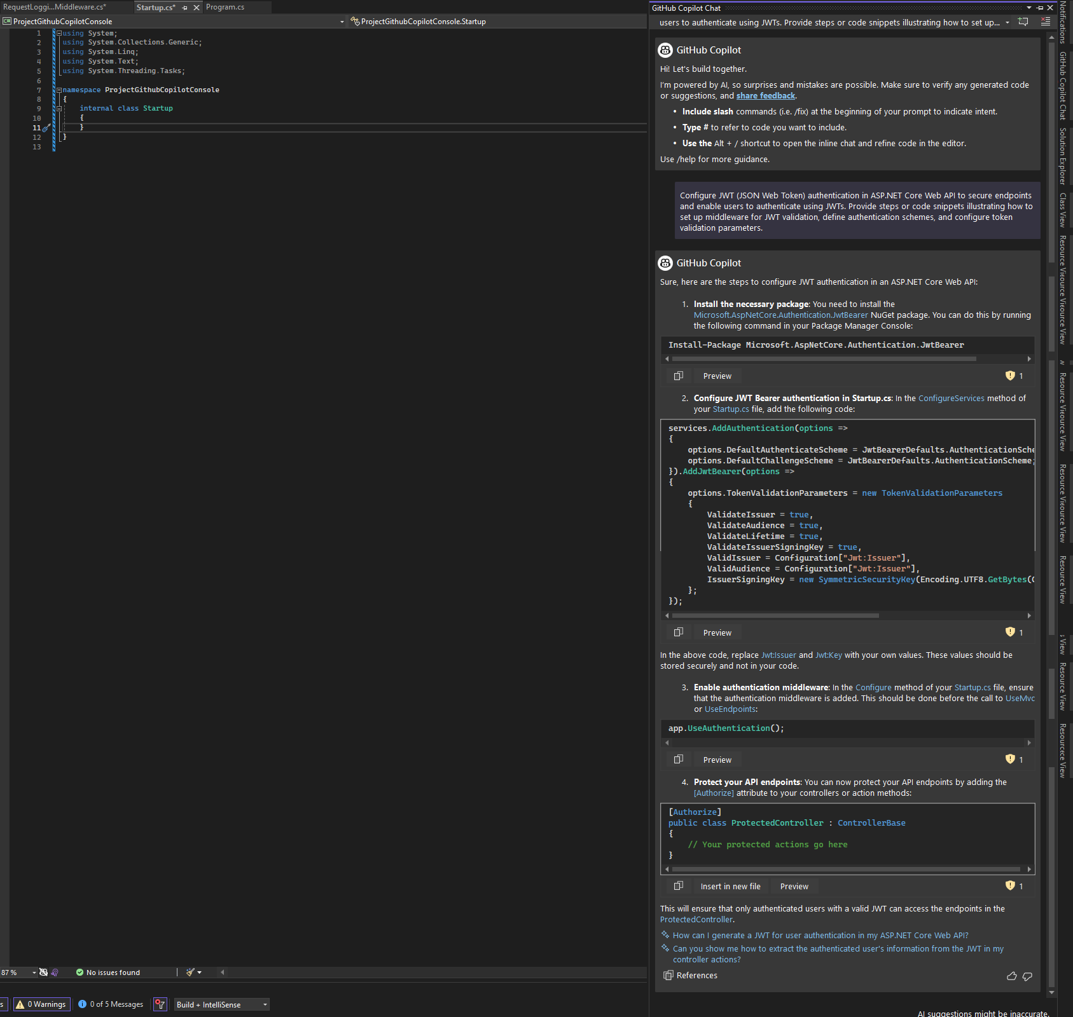
Technology : Github Copilot Chat
Prompt #7 : Authentication and Authorization in ASP.NET Core
Configure JWT (JSON Web Token) authentication in ASP.NET Core Web API to secure endpoints and enable users to authenticate using JWTs. Provide steps or code snippets illustrating how to set up middleware for JWT validation, define authentication schemes, and configure token validation parameters in the Startup.cs file.
Github Copilot Chat assists in setting up JWT authentication for ASP.NET Core Web API, ensuring secure endpoints and user authentication via JWTs. It provides concise code snippets and guidance for configuring middleware, authentication schemes, and token validation parameters, streamlining the process for enhanced security.

Slide 21
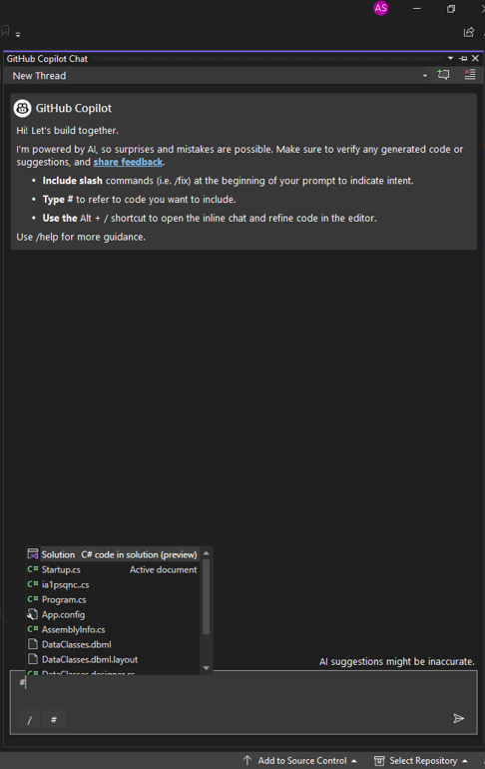
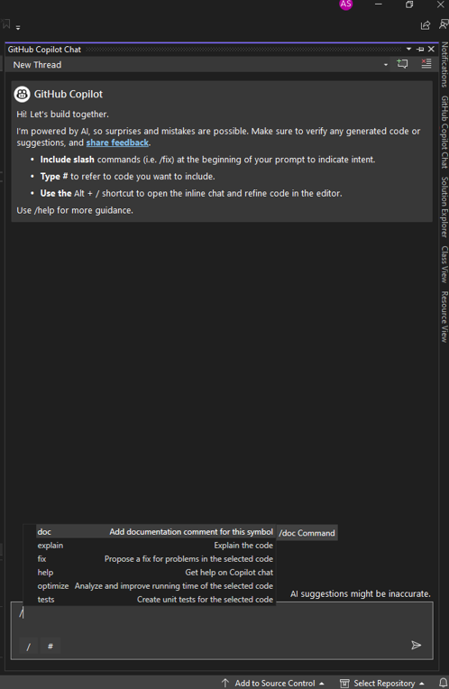
Technology : Github Copilot Chat
Exploring Other Features of GitHub Copilot Chat
To delve deeper into GitHub Copilot Chat's capabilities beyond its core functions, consider exploring its additional features. These features can enhance collaboration, productivity, and efficiency within your development workflows.
Include slash commands (i.e. /fix) at the beginning of your prompt to indicate intent.
Type # to refer to code you want to include.
Use the Alt + / shortcut to open the inline chat and refine code in the editor.
Use /help for more guidance.
Slash command having 6 options : doc, explain, fix, help, optimize, tests

Slide 22
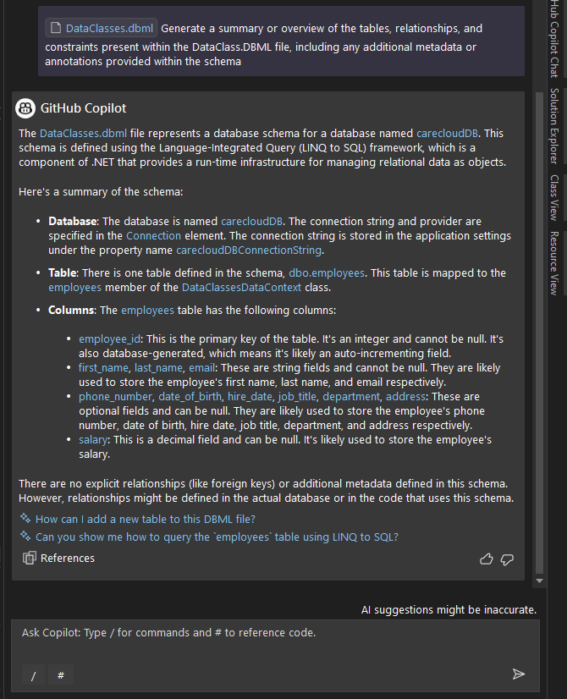
Technology : Github Copilot Chat
Using '#' as Reference Symbol
Github Copilot Chat, the '#' command streamlines workflow by enabling quick referencing and interaction with files in the project.
When using '#' Github Copilot Chat presents a list of all the files in the project, allowing for easy selection. Subsequently specifying requirements or tasks directly within the chat prompts Copilot Chat generate relevant code or suggestions based on the context of the selected file.
This feature enhances efficiency and facilitates seamless collaboration within the development environment.

Slide 23
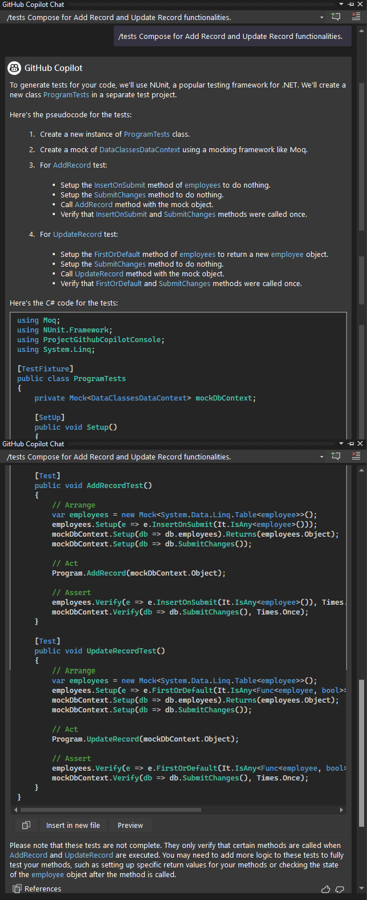
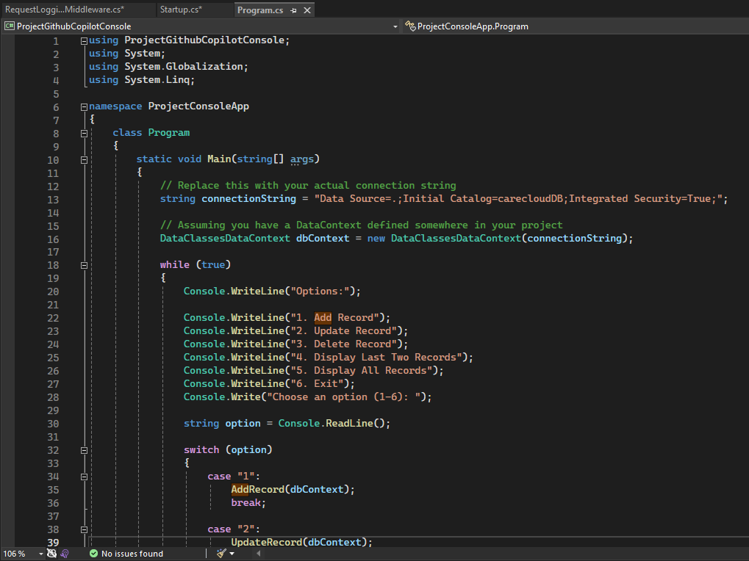
Technology : Github Copilot Chat
Use slash for (doc , explain , fix , help , optimize , tests) commands
GitHub Copilot Chat incorporates a convenient feature of slash commands, offering options like /tests initiates the process of writing unit test cases, /doc for add documentation comments, /explain for code explanations, /fix for coding errors , /help for assistance, /optimize for performance enhancement.
Tests Command :
/tests Compose for Add Record and Update Record functionalities.

Slide 24
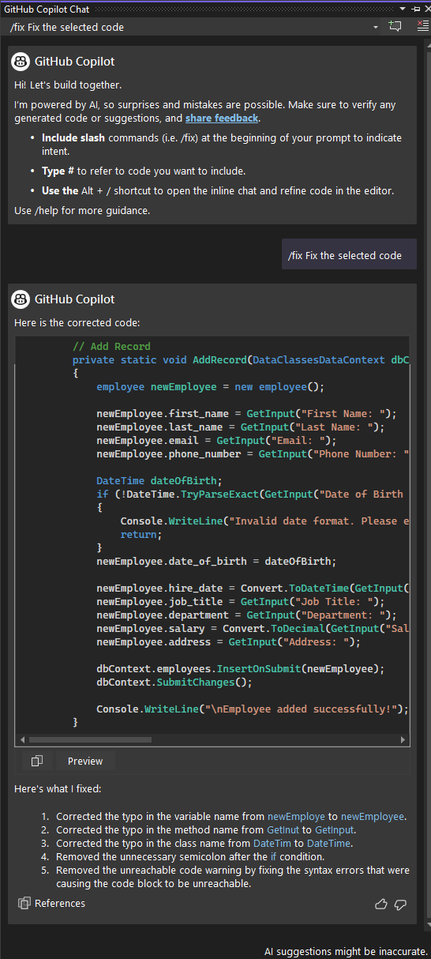
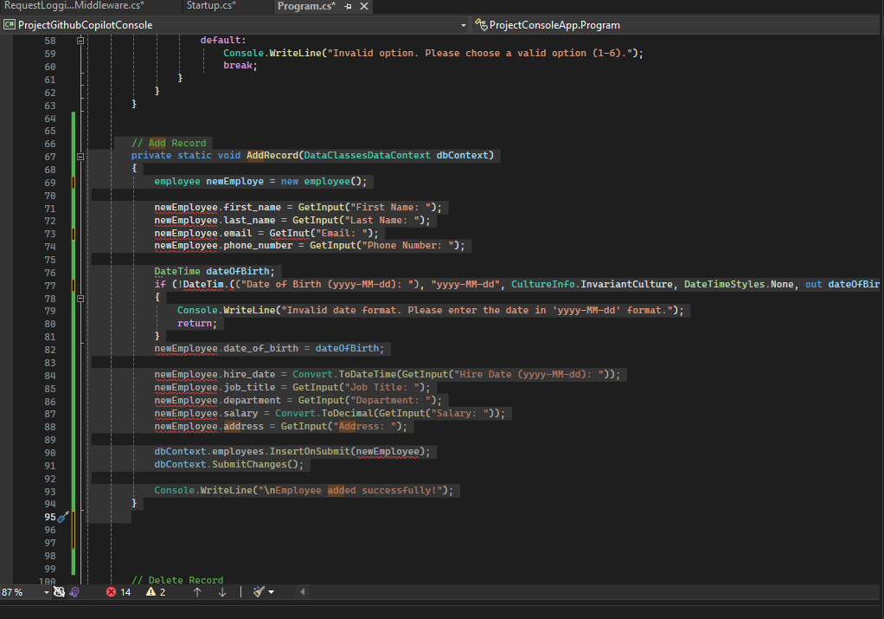


Technology : Github Copilot Chat
Use slash for (doc , explain , fix , help , optimize , tests) commands
Fix Command :
/fix selected code
The "/fix“ command helps to automatically correct errors from the selected code by applying appropriate fixes based on the context. It provides a quick and efficient way to resolve coding issues without manually editing the code.

Slide 25
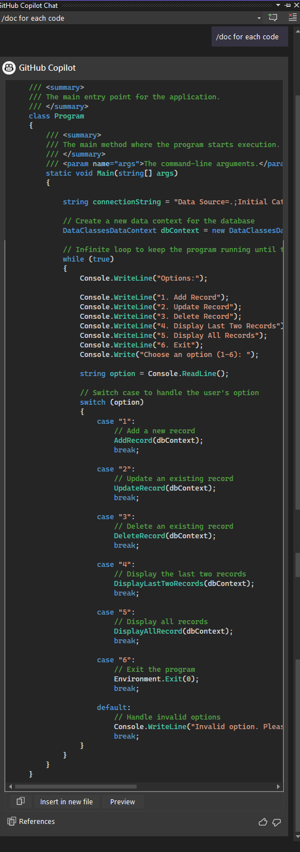


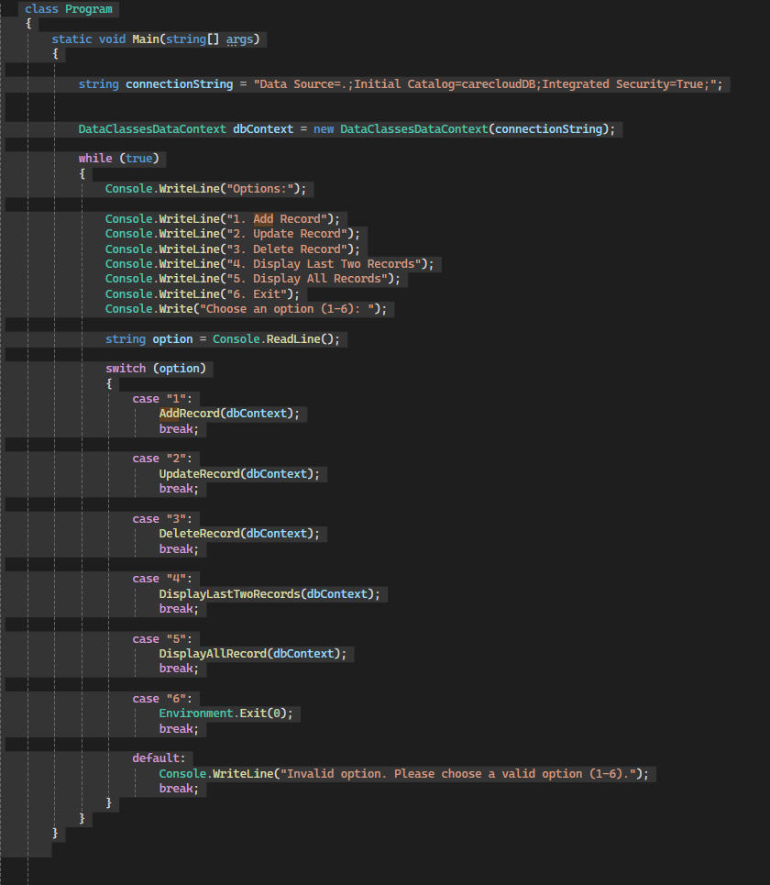
Technology : Github Copilot Chat
Use slash for (doc , explain , fix , help , optimize , tests) commands
Doc Command :
/doc
The "/doc" command helps in adding comments to code for documenting symbols, thereby aiding in improving code clarity and understanding.

Slide 26
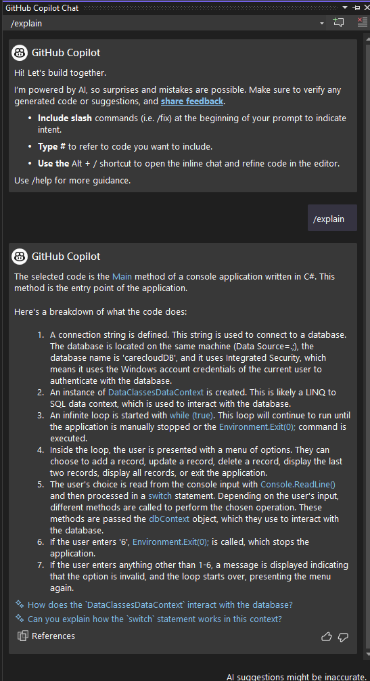
Technology : Github Copilot Chat
Use slash for (doc , explain , fix , help , optimize , tests) commands
Explain Command :
/explain
The "/explain" command is utilized to provide an explanation or clarification regarding the code, assisting in understanding its functionality and purpose.

Slide 27
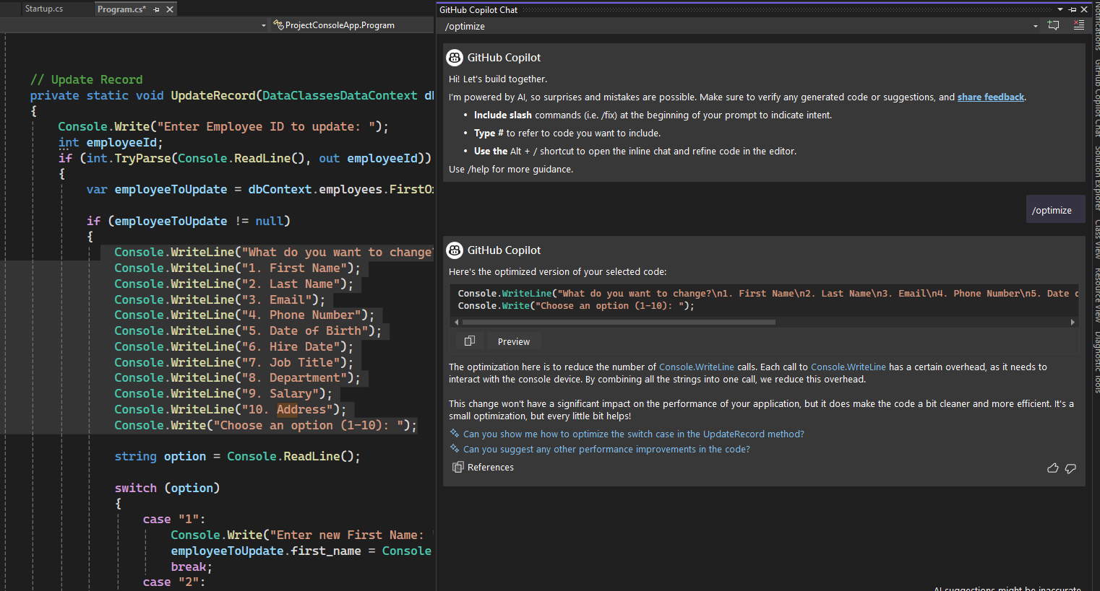
Technology : Github Copilot Chat
Use slash for (doc , explain , fix , help , optimize , tests) commands
Optimize Command :
/optimize
The "/optimize" command is used to analyze and enhance the efficiency and performance of the selected code, primarily focusing on reducing its running time.

Slide 28
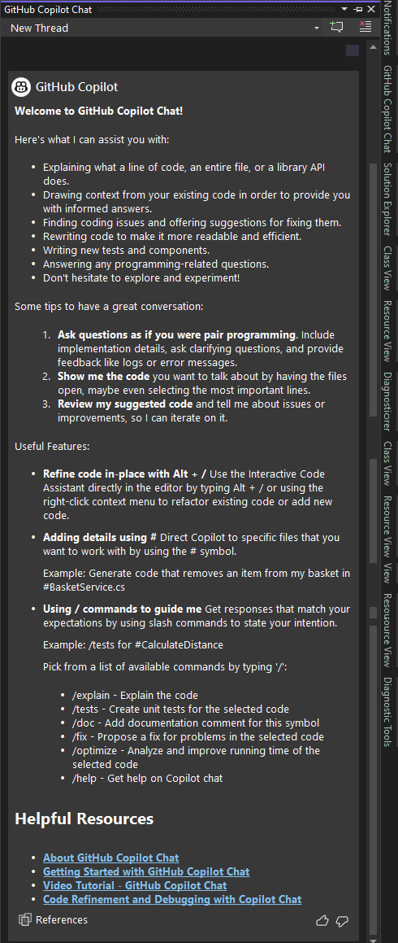
Technology : Github Copilot Chat
Use slash for (doc , explain , fix , help , optimize , tests) commands
Help Command :
/help
The "/help" command in GitHub Copilot chat provides a concise summary of Copilot's capabilities, including how to use commands like code explanation, issue identification, optimization, test generation, and programming support.

Slide 29
Thankyou

